Slide 1
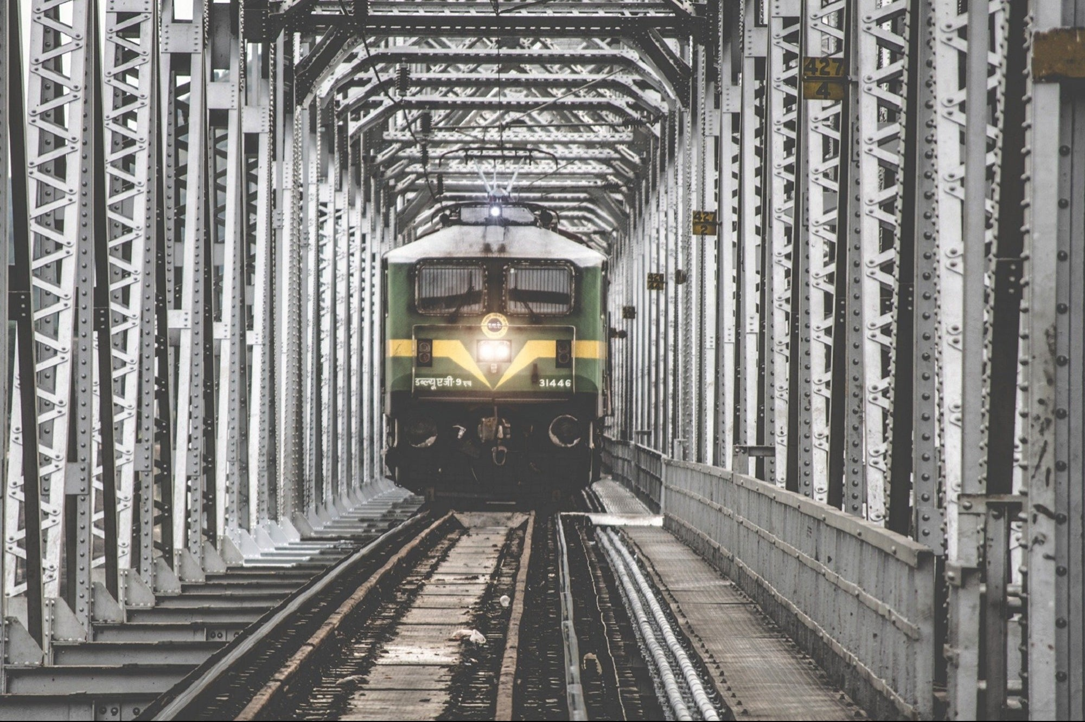
DATA ANALYSIS & vIZUALISATION

Slide 2
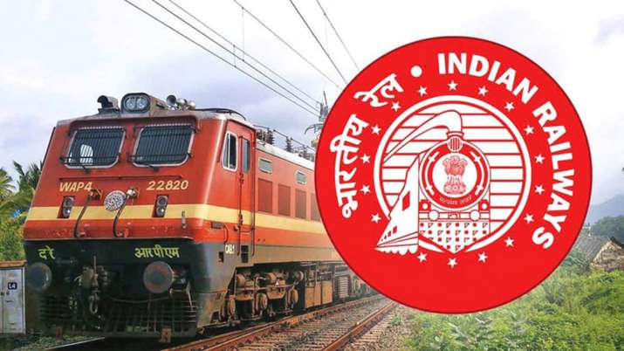
CASE STUDY
INDIAN RAILWAYS 1950-2020

Slide 3
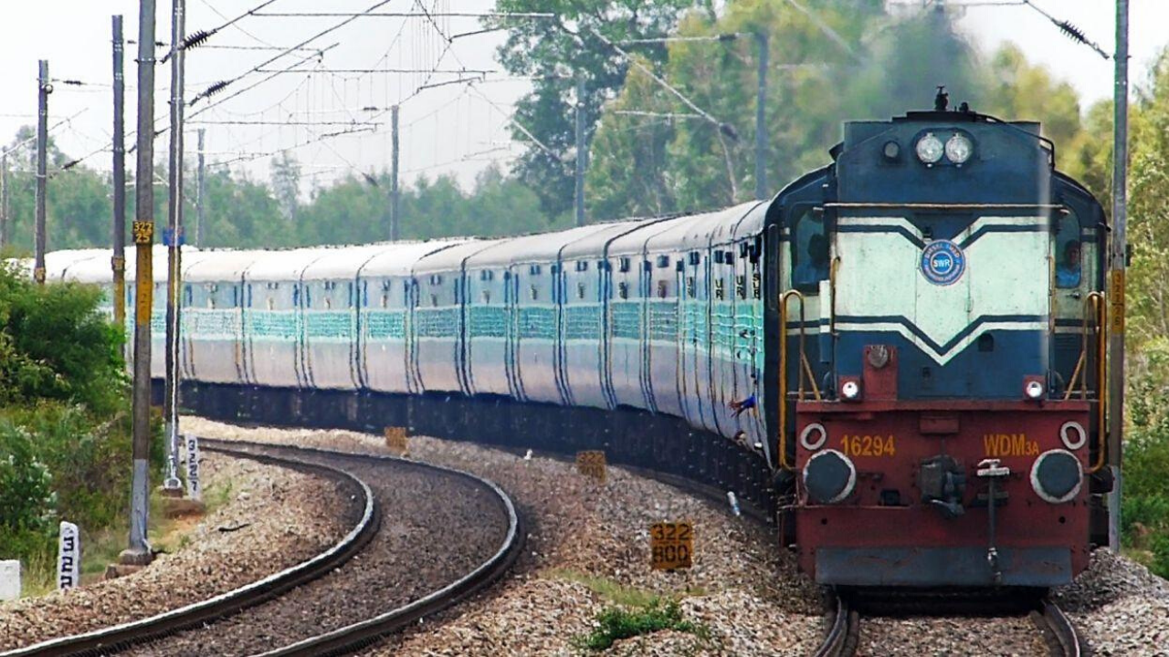
FOURTH LARGEST IN THE WORLD
On a daily basis Indian rails can cover earth 1.5 times

Slide 4
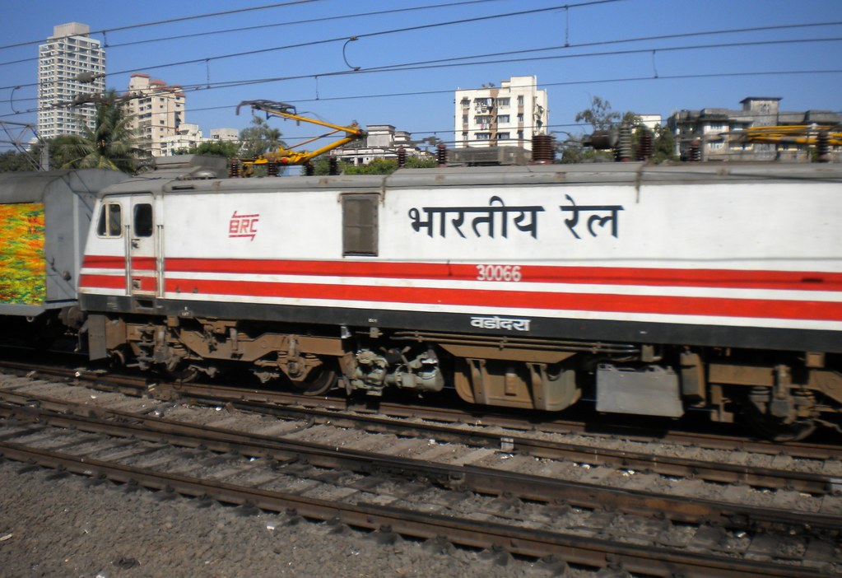
REG DATA
The Data is resourced from google
It is a statistical summary of Indian railways from 1950 to 2020
The pdf was connected through power query connection
The data was cleaned,organized and rearranged in power query editor
Some part of analysis was performed in MS Excel 365
The vizualisation part was completely done in Microsoft Power BI
This Photo by Unknown Author is licensed under CC BY-SA

Slide 5



TOOLS USED
CLUSTERED COLUMN CHART
LINE CHART
CARDS & METERS
AREA CHARTS
BAR CHARTS
Power query
REDUCING ROWS
REPLACING VALUES
CHANGING DATA TYPES
REMOVING NULLS
EXTRACTING COLUMNS
TRANSPOSING COLUMNS
REORDERING COLUMNS
EXAMPLE COLUMNS
POWER BI
This Photo by Unknown Author is licensed under CC BY

Slide 6

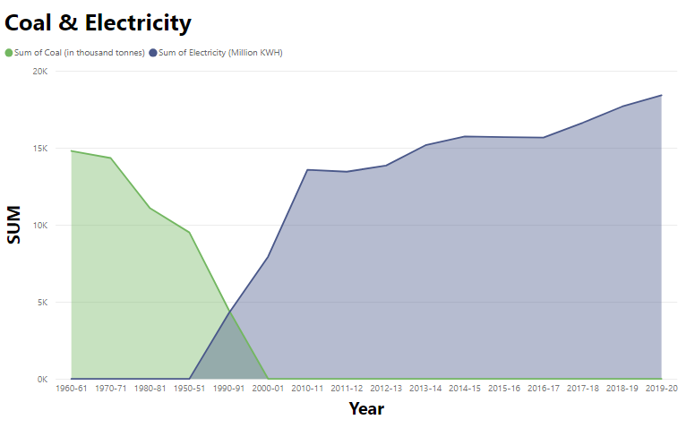
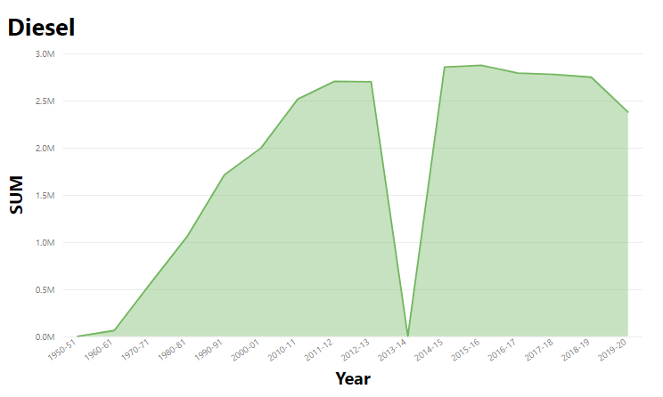
FUEL TYPE

Slide 7

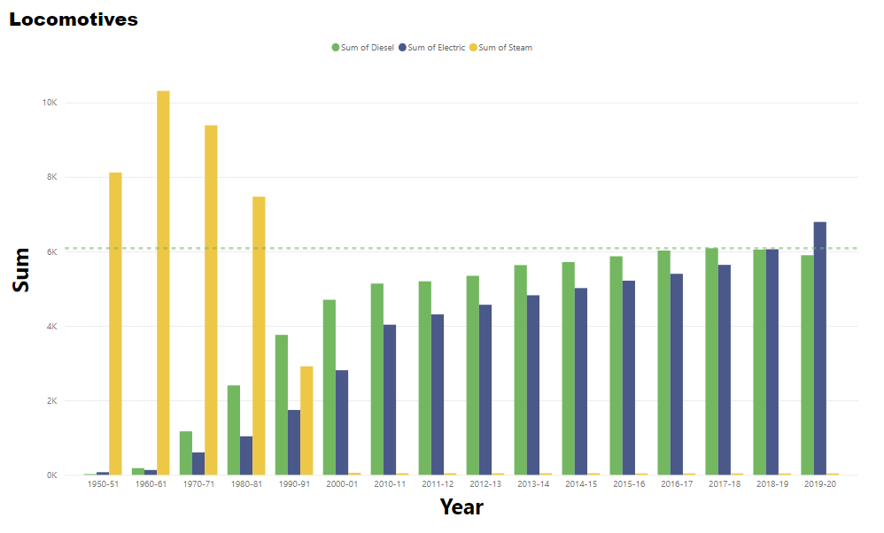
locomotives

Slide 8

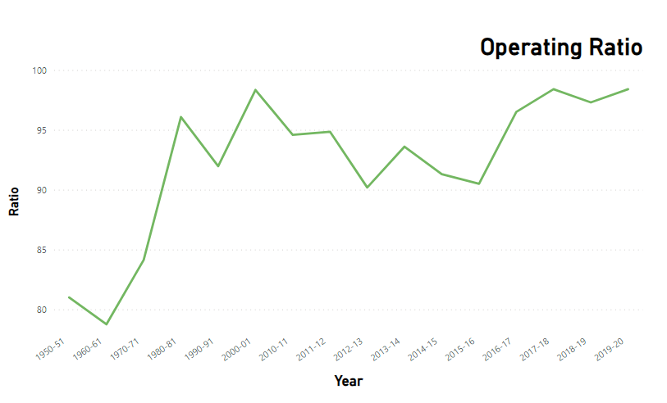

Revenue & expenditure
91% OF REVENUE IS GOING BACK INTO EXPENDITURE
95 %
INDIGENOUS
PURCHASES

Slide 9

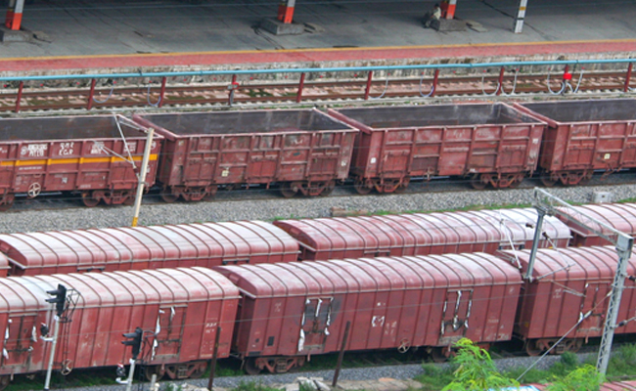
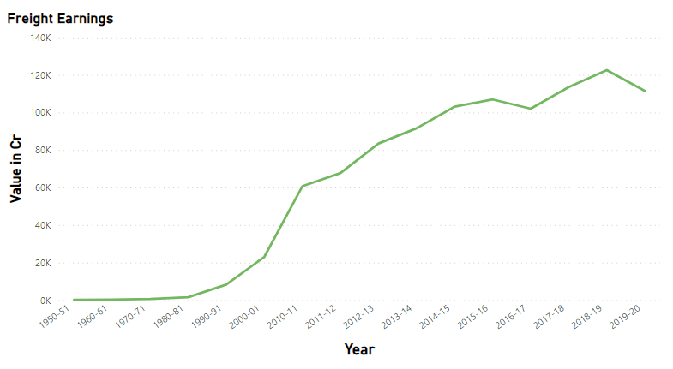
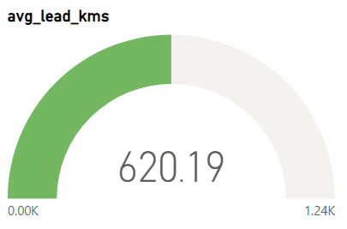
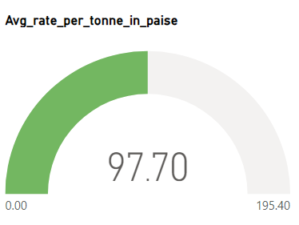
FREIGHT

Slide 10

Passengers INVESTMENT
62% FOR ENHANCEMENT
8255
Million
1134523
Kms

Slide 11

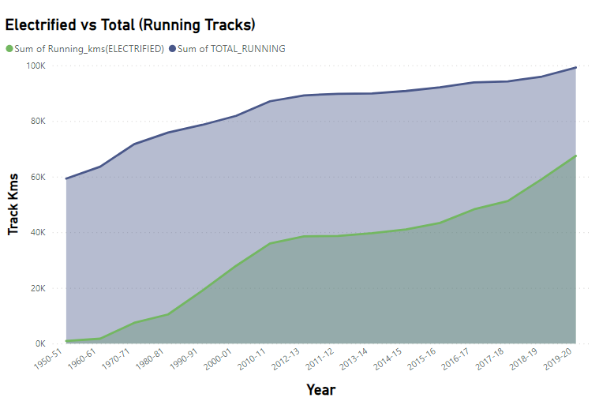
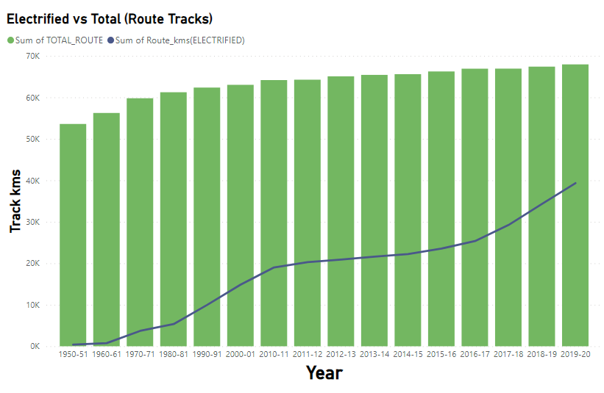
tracks

Slide 12

Operating costs & NEW STATIONS

Slide 13

EMPLOYEES
1254000+
EMPLOYEE
1950 TO 2020
974 TIMES INCREASE IN AVG WAGES

Slide 14
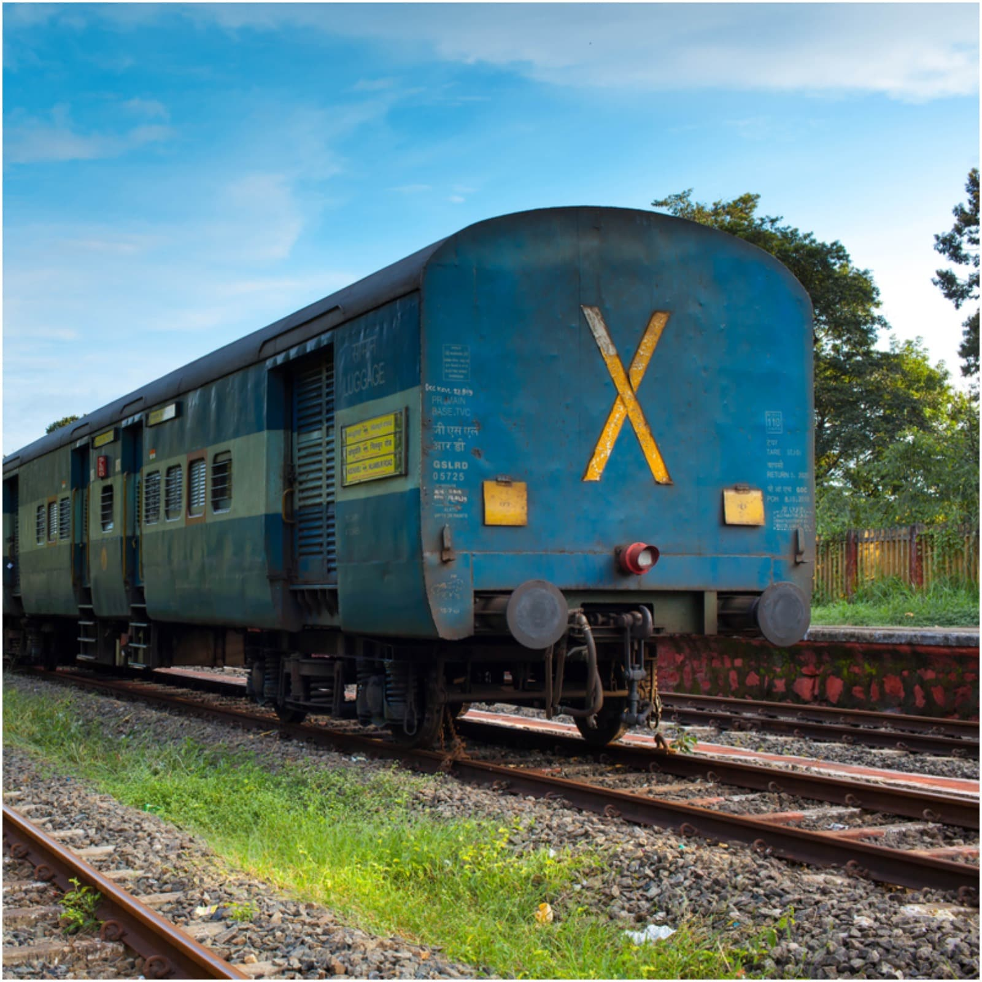
Ir Still continues+

